Slide 1


UNIFIED HR
MANAGEMENT INFORMATION SYSTEM
Tracking Employees, Recruitment, Onboarding, Promotions, Training, & Exits

Slide 2

THE HR MESS - BUSINESS PROBLEM & OBJECTIVES
Picture this:
A multi-location company with 2,000 employees lacked a unified HR system, causing data silos, delayed insights, and inefficient workforce management.
Mission:
Build an MIS so powerful, it practically runs HR for us.
Main objectives:
Capture everything from hiring to exits
Automate boring bits
Wow managers with live dashboards

Slide 3
STEP 1: UNDERSTANDING THE BUSINESS SCENARIO
A company with 2,000 employees across multiple locations lacked a unified HR system.
Goal: Build an MIS to track employees, recruitment, onboarding, promotions, training, and exits to provide real-time insights and streamline HR management.
STEP 2: GATHERING DATA REQUIREMENTS
Identified necessary data entities and attributes like employee personal info, department, recruitment status, training progress, etc.
Generated AI-based realistic fake datasets to simulate actual HR records and workflows.

Slide 4
THE DATA WE WANT
Factor | Calculation | Result
Employees (core stats) | Who’s on board | Headcount, demographics in dashboards
Departments | Who owns what? | Workforce planning, cost centers
Recruitment | Where we find talent | Analyze hiring efficiency/trends
Onboarding/Training | Ready for duty? | Track skills & ramp-up
Promotions | Career rockets | Promotion and growth analysis
Exits | Who left (& why) | Spot trends and fix leaky buckets

Slide 5
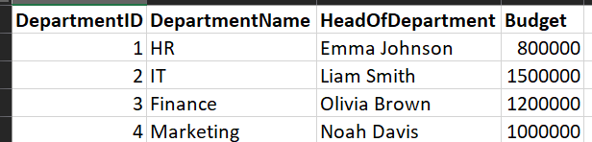
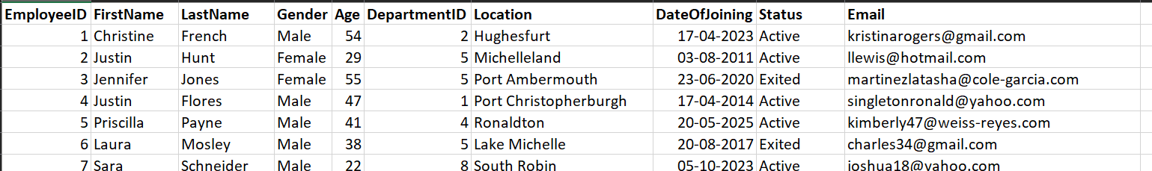
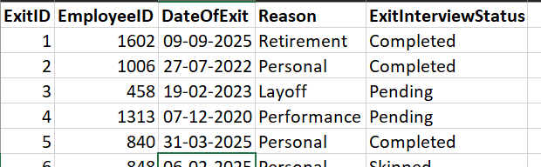
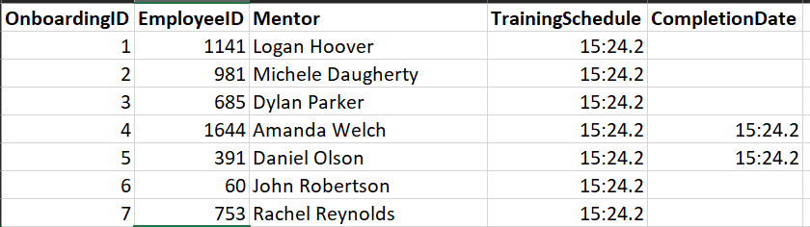
Departments.csv
Employees.csv
Exits.csv
Onboarding.csv

Slide 6
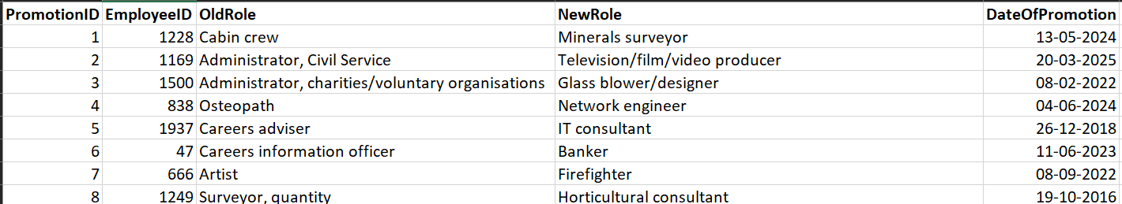
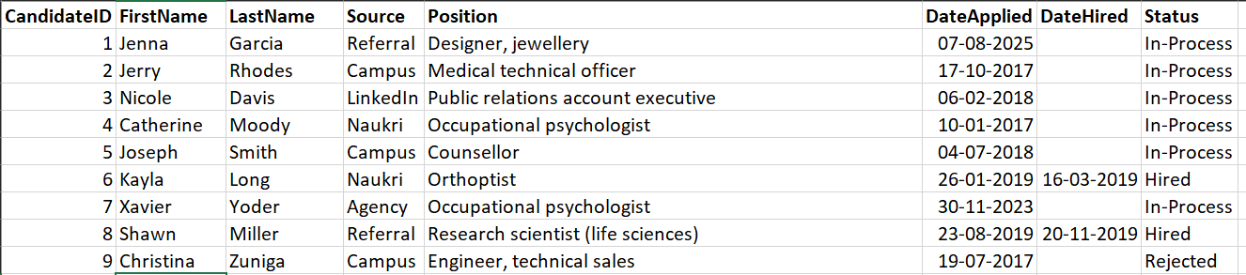
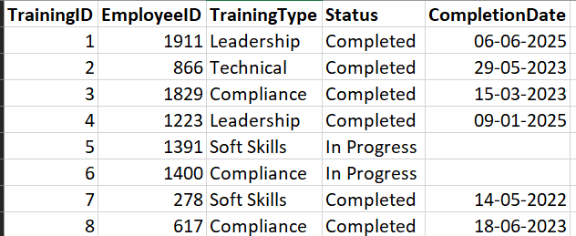
Promotions.csv
Recruitment.csv
Training.csv

Slide 7
STEP 3: UDESIGNING THE DATABASE STRUCTURE
Designed a normalized MySQL database schema up to Third Normal Form (3NF) to avoid redundancy and optimize data integrity.
Created the main tables: Departments, Employees, Recruitment, Onboarding, Promotions, Training, and Exits.
Defined primary and foreign key relationships to maintain referential integrity.
Ensured each event table links back to Employees via foreign keys.
STEP 4: CREATING DATABASE TABLES
Wrote and executed SQL scripts to create tables with appropriate datatypes, constraints, and relationships.

Slide 8
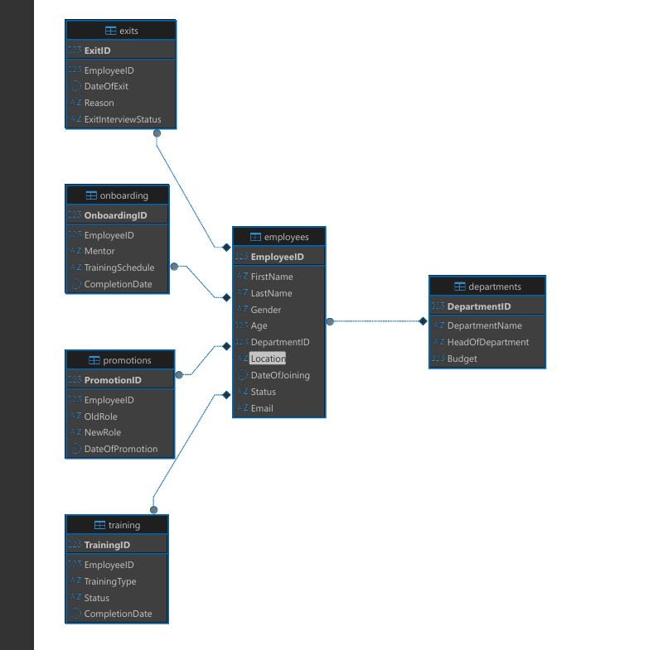

Slide 9
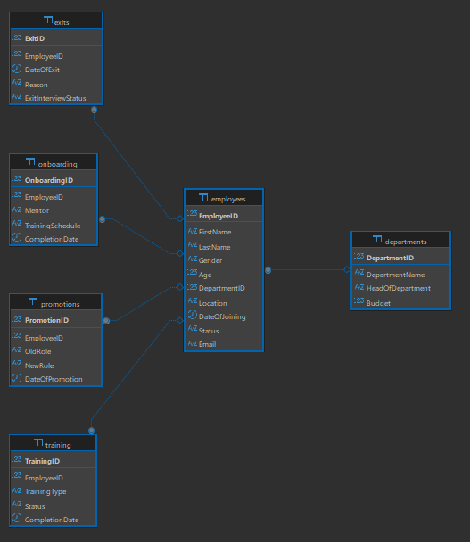
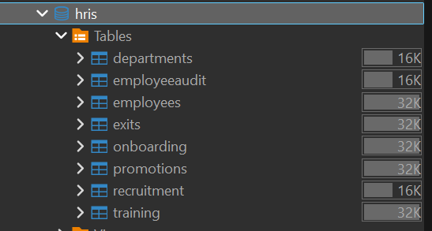

Slide 10
OVERVIEW OF MAJOR TABLES
Table | Key Fields | Relationship Description
Departments | DepartmentID (PK), DepartmentName | Links to multiple employees
Employees | EmployeeID (PK), DepartmentID (FK), Status | Central to all lifecycle event tables
Recruitment | CandidateID (PK), Source, Status | Pre-employment data
Onboarding | OnboardingID (PK), EmployeeID (FK), Mentor | Tracks new employee integrations
Promotions | PromotionID (PK), EmployeeID (FK), NewRole | Records employee advancement
Training | TrainingID (PK), EmployeeID (FK), CompletionDate | Tracks employee learning status
Exits | ExitID (PK), EmployeeID (FK), Reason | Captures employee departure reasons

Slide 11
STEP 5: IMPLEMENTING TRIGGERS AND BUSINESS LOGIC
Created MySQL triggers to automate business rules:
Auto-update employee status to “Exited” upon exit entry.
Block promotion of employees who are not “Active.”
Automatically fill onboarding completion date after scheduled training passed.
Maintain audit log of employee status changes for traceability.
These enforced real-time data consistency and business constraints server-side.

Slide 12
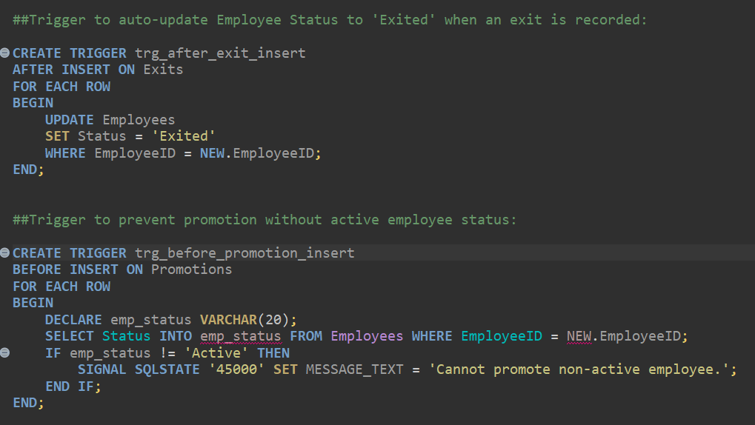
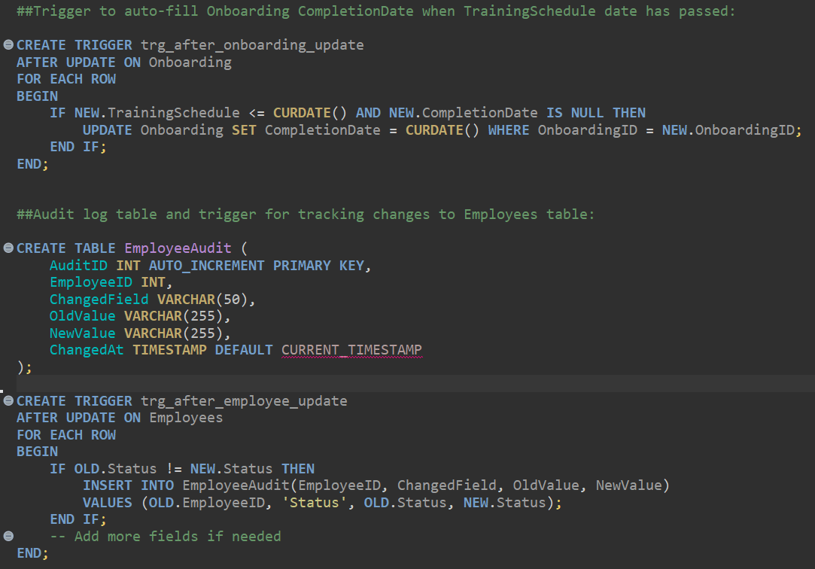
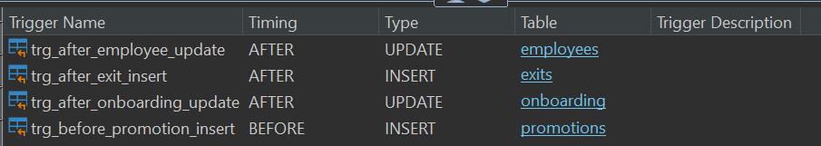

Slide 13
OVERVIEW OF TRIGGERS IMPLEMENTED
Trigger Name | Purpose | Business Rule Enforcement
trg_after_exit_insert | Updates employee status to ‘Exited’ upon exit. | Reflects timely workforce status change
trg_before_promotion_insert | Prevents promotion of non-active employees. | Maintains valid promotion records
trg_after_onboarding_update | Auto-fills onboarding completion when scheduled. | Ensures accurate training completion records
trg_after_employee_update | Logs changes in employee status for audit purposes | Supports accountability and historical tracking

Slide 14

AUDIT LOGGING FOR EMPLOYEE STATUS CHANGES
Created EmployeeAudit table to record changes to employee status.
Trigger trg_after_employee_update inserts audit records for status updates.
This enables traceability and accountability for workforce changes.

Slide 15
STEP 6: WRITING VIEWS AND KEY QUERIES
Developed SQL views to provide summarized, filtered, and aggregated data used in dashboards:
Employee count by department and status.
Recruitment source effectiveness.
Training completion status by type.
Promotion trends by year.
Exit reasons with interview status.
Tested queries to verify results before connecting to BI layer.

Slide 16
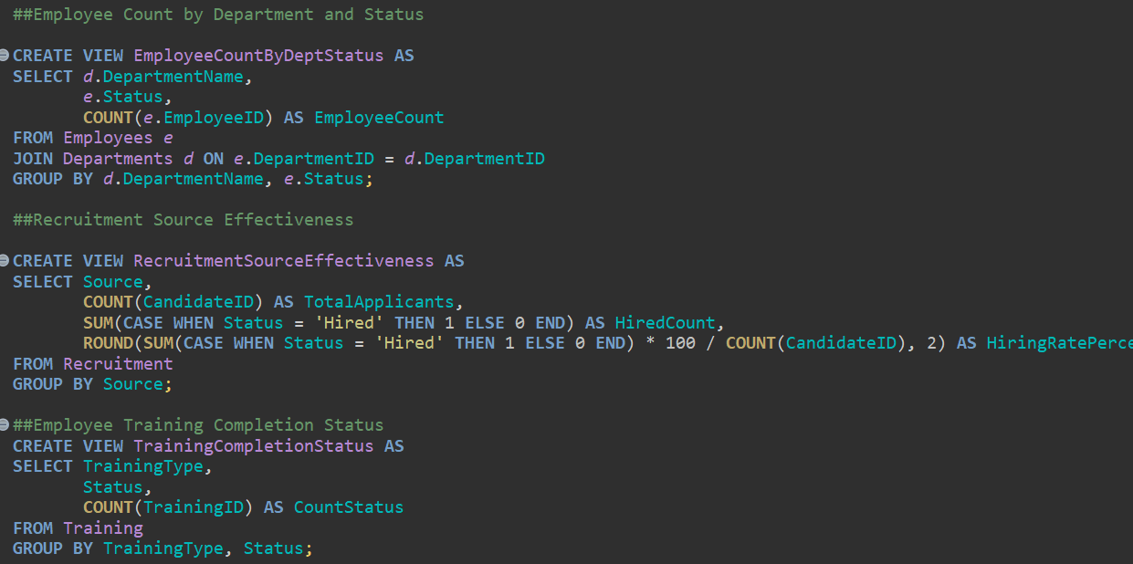
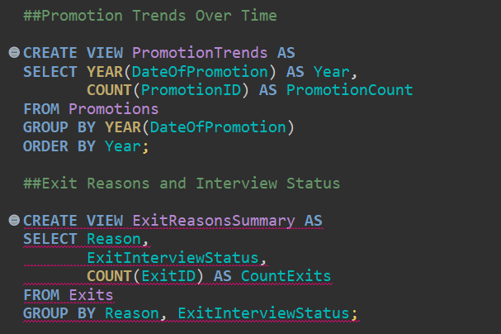
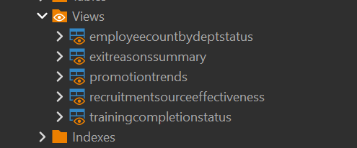

Slide 17
ESSENTIAL SQL VIEWS FOR REPORTING
View Name | Purpose | Dashboard Use
EmployeeCountByDeptStatus | Counts employees grouped by department and status | Staffing and status trend charts
RecruitmentSourceEffectiveness | Measures recruitment source success rates | Evaluates recruiting channel effectiveness
TrainingCompletionStatus | Aggregates training types and their completion statuses | Visualizes training progress
PromotionTrends | Counts promotions over time | Supports monitoring career progression
ExitReasonsSummary | Summarizes exit reasons with interview status | Aids in turnover analysis and retention strategies

Slide 18
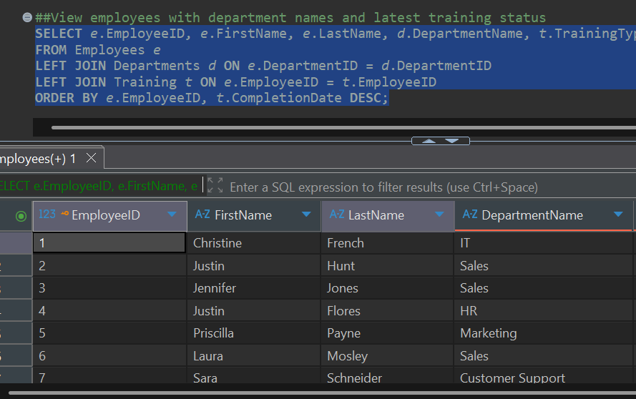
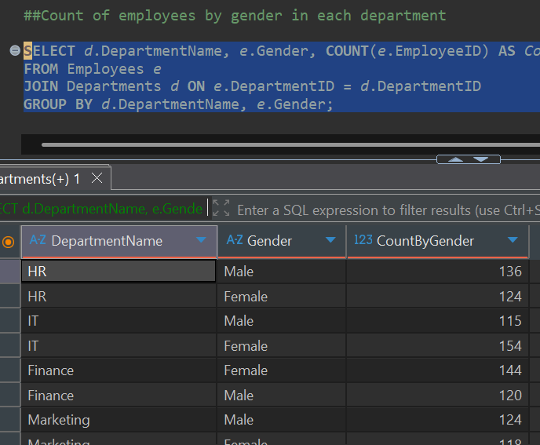

Slide 19
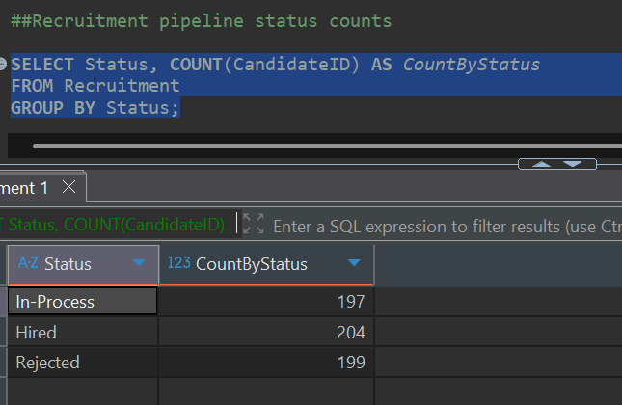
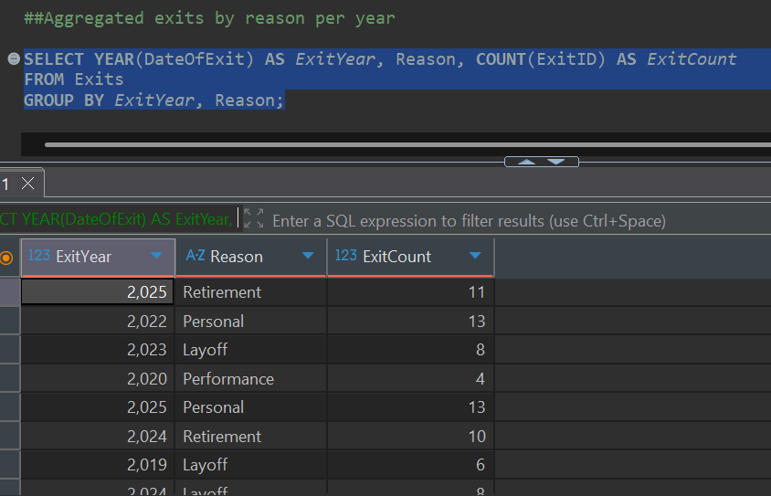

Slide 20
STEP 7: CONNECTING MYSQL DATABASE TO POWER BI
using https://dev.mysql.com/downloads/connector/net/
Integrated MySQL database with Power BI Desktop using direct connectors.
Set up relationships and data modeling within Power BI for comprehensive visualization.
STEP 8: DEVELOPING POWER BI DASHBOARDS
Created multiple interactive dashboards aligned with business objectives:
Workforce Overview & Demographics.
Training & Development Analytics.
Turnover, Promotions & Recruitment Funnel.
Used charts, KPIs, and filters to highlight actionable insights for HR managers.

Slide 21
SUMMARY OF THE DASHBOARDS
Dashboard Name | Purpose | Managerial Insights Provided
Workforce Overview and Demographics | Provide a snapshot of current workforce composition and employee status | Identify workforce size, distribution, gender balance, and hiring trends; assess attrition levels and workforce renewal
Training and Development Analytics | Evaluate training participation and completion status across departments | Identify training gaps, track employee development efforts, and support skill building and compliance initiatives; drive targeted learning and development programs
Turnover, Promotions & Recruitment Funnel | Analyze recruitment pipeline stages, employee turnover reasons, and promotion trends | Understand recruitment efficiency, reasons for employee exits, attrition rate trends, and promotion volumes over time; focus retention strategy and improve hiring pipeline

Slide 22
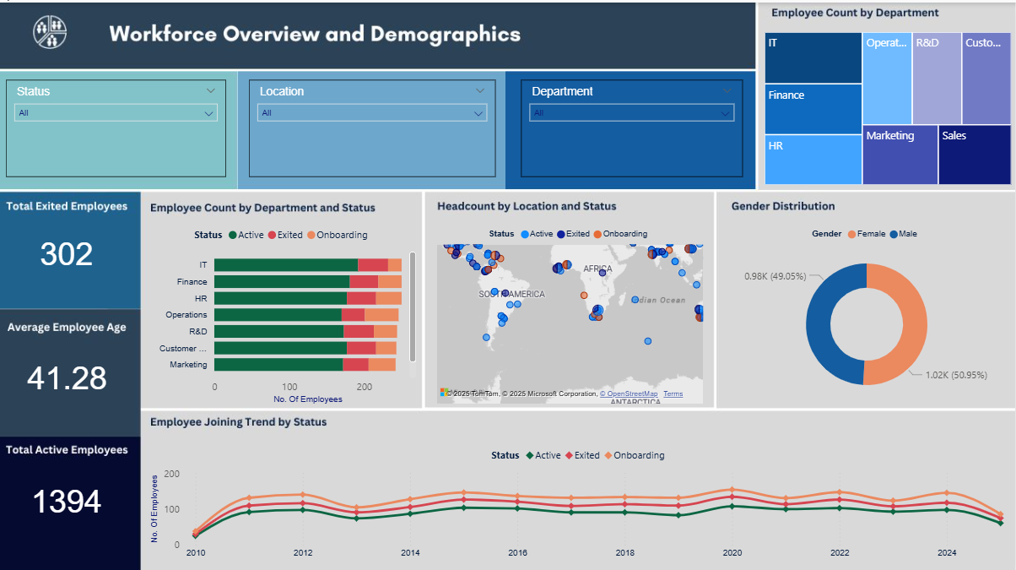

Slide 23
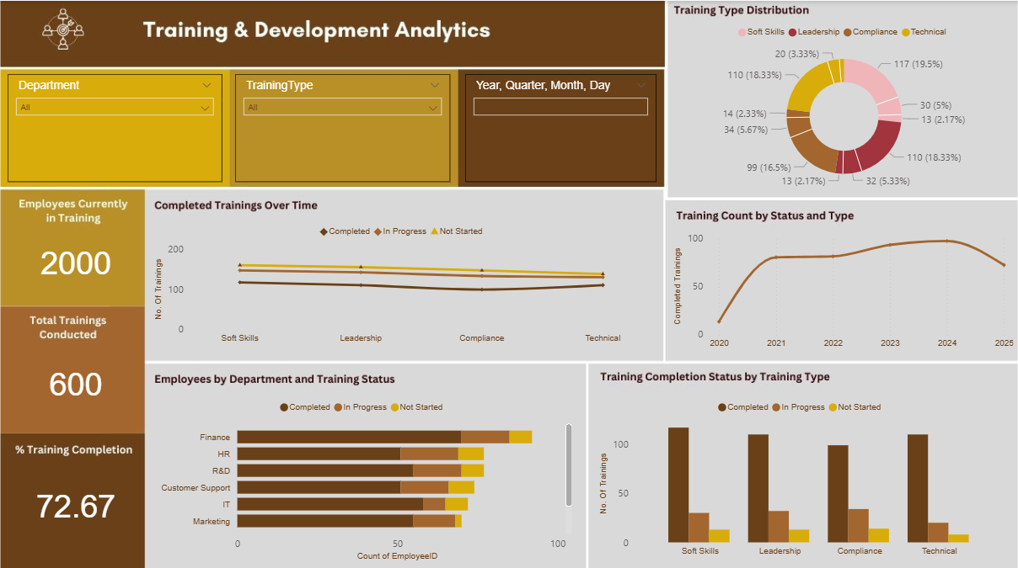

Slide 24
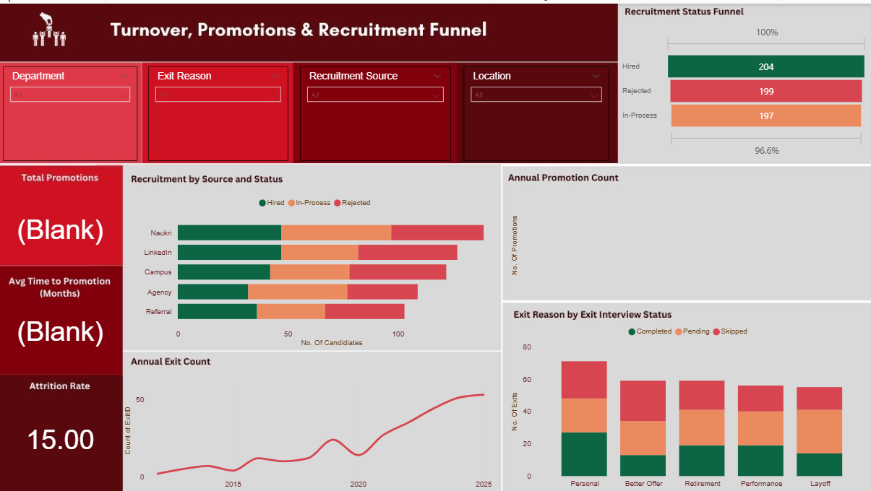

Slide 25
STEP 9: MANAGERIAL INSIGHTS
Workforce Overview:
Easily observe active vs exited employees and demographic trends.
Identify departments with high turnover and aging workforce to prioritize retention and recruitment.
Gender distribution insights to support diversity and inclusion initiatives.
Recruitment & Turnover Funnel:
Pinpoint which recruitment sources yield the best hires.
Monitor pipeline stages proactively to reduce hiring delays.
Understand primary exit reasons – whether it's better offers, retirement, or layoffs – to tailor retention strategies.
Training Analytics:
Assess training completion rates by department and skill type.
Identify skills gaps and plan targeted learning programs.
Track progressive improvement or stagnation in employee development.

Slide 26
STEP 10: OVERALL IMPACT
How the MIS solved the problem:
Unified data from multiple HR functions into a single, consistent MySQL database.
Automated critical HR processes via triggers, reducing errors and manual overhead.
Delivered dynamic and interactive Power BI dashboards that refresh live, providing timely and relevant decision support.
Future possibilities:
Integrate predictive analytics to forecast turnover and hiring needs, moving from reactive to proactive HR.
Introduce employee satisfaction and engagement metrics to fully capture workforce health.
Develop mobile-friendly dashboards so managers can stay informed anytime, anywhere.
Implement automated alerts for key HR events to enable faster response to workforce issues.

Slide 27
THANK YOU

